Slide 1
Hasbro clothing
Analytics perspective

Slide 2
Scope of the pilot
To mine the customer and transaction data sources to gain insights on product affinities.
Analytics reports for sell through replenishments
Data Source : MySQLDB with 2016 & 2017 data

Slide 3
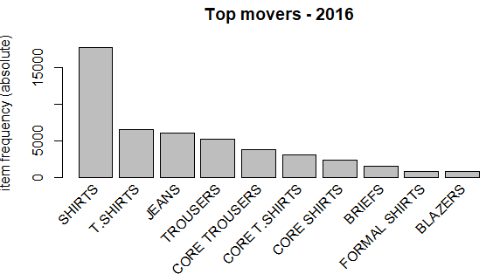
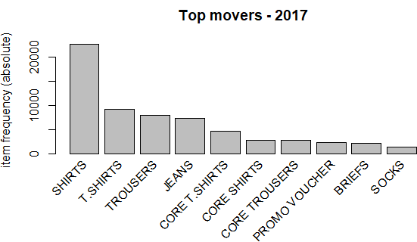
Hasbro – Top movers 2016 & 2017
The top 10 moving products for 2016 and 2017 do not have much changes.
Shirts dominates the sales followed by T.shirts.
In 2017 Trousers outpaced Jeans to get in to 3rd position.
Promo Vouchers were the new addition in 2017

Slide 4
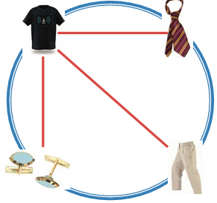
Product affinities – Rule generation
Apriori algorithm was used to generate product affinities separately for 2016 and 2017 years
Rules were generated for all the products based on confidence and lift metrics
Customer and Product matrix data was generated to zero-in on any ‘NOT BOUGHT’ customer analysis.
‘Not bought customers’ case pertaining to target customers having not bought T.Shirts and Jeans (including core.Tshirts and Core Jeans) for 2016 & 2017 data comes around 30,262.

Slide 5
Targeting items – Using Association rules
What are customers likely to buy before buying Jeans ?
What are customers likely to buy if they purchase Bags?
Customer preferences and buying pattern can be used for personalized promotion offers (works as a elementary recommender system)
Regional and store wise analysis results in products moving/not moving in stores and to understand the customer segments
Product affinity rules gives us the ability to find expected/unexpected buying trend which can be used for cross-merchandising and joint-promotional displays.

Slide 6
Key metrics addressed by Market basket analysis
Total Store baskets – Baskets at customer level for a given timeframe
Units per basket - Average units for baskets containing selected products
Interaction – The interaction effects of products based on rules which decides sales

Slide 7
Customer probability models – RF based Analysis

Slide 8
What customer probability model provides business ?
This class of models has been developed for non-contractual settings kind of businesses.
The probability that a customer has made ‘x’ repeat purchases within ‘t’ time periods.
The expected number of repeat purchases for a customer within ‘t’ time periods.
Historical probabilities of when the customer was active in his whole tenure with the business in the given timeframe.

Slide 9
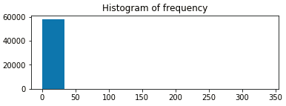
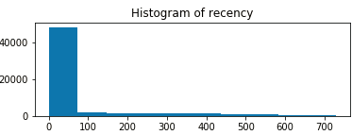
Exploration of customer base – Frequency and Recency metric
The repeat purchases range from 0 – 40 among the customer base
The recency spread is more within 0 – 100 days range

Slide 10
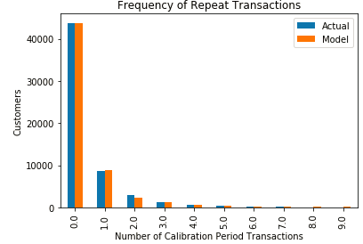
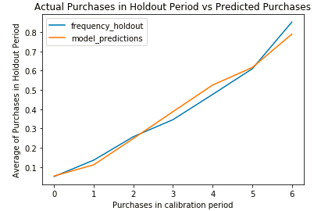
BG-NBD model - Validation
The model does a good job of predicting repeat transactions up until 7 and progressively decay
Also the actual and hold out period average purchases performs well until 5 with very little overfitting.

Slide 11
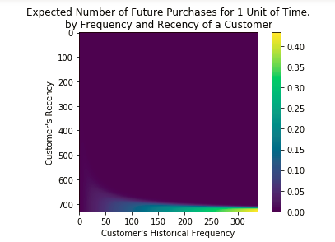
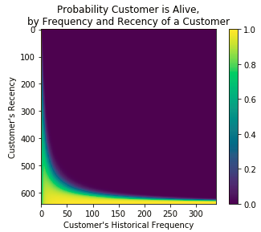
How RFA components affects our model?
Intuitive to understand customers with higher R and F components purchase more and have longer relationship.
The customers in the light blue colour in the second graph requires extra servicing and wooing as their probability exists in the 0.6-0.8 range and may be they are in the midst of their purchase cycle.

Slide 12
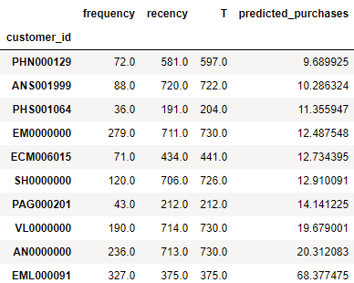
Projecting future sales of customer base
The model was tuned to project the future expected number of purchases from customers for the next 3 months time period.
The top 10 customers list based on the model has been shared here.
Notes:
Expected number of purchases over ‘X’ days of time – X can be next time period or months .

Slide 13
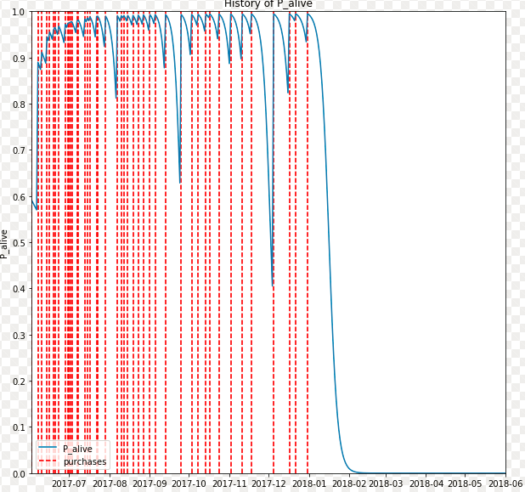
Inferences from Historical purchase history
Transaction pattern of one of the selected top 10 customers from the previous model
Notes:
Customer selected : PAG000201

Slide 14
Queries ?

Slide 15
THANKS FOR THE OPPORTUNITY!!!

